Slide 1
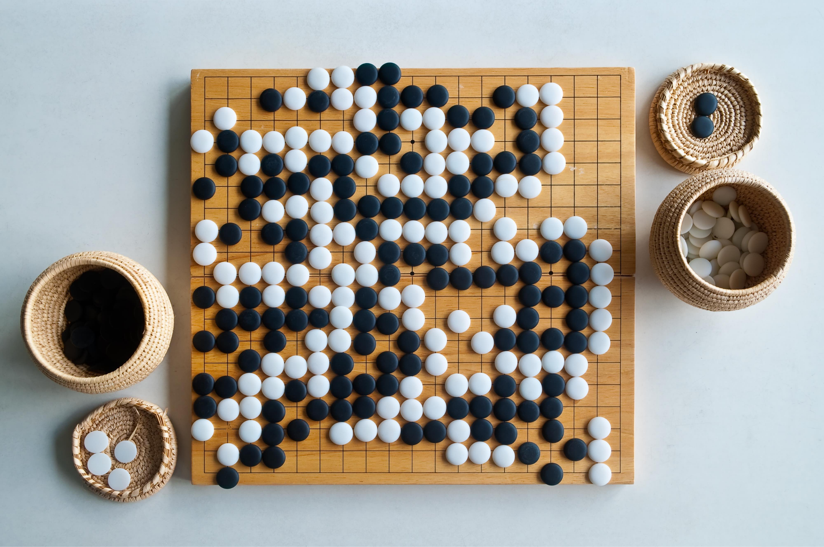
AlphaGo
2022 - 2023 - Théo Matricon

Slide 2
Time
4 TDs
12h
1 project

Slide 3
Objective
A Go player, there are 3 levels:
1) MCTS Go Player (same as 2nd year so <10 grade)
2) NN guided MCTS Go Player
3) RL Learning MCTS Go Player

Slide 4
Supports
The movie
The original Alpha papers
ELF Go
Me

Slide 5
Other references
Improvements to Increase the Efficiency of the AlphaZero Algorithm: A Case Study in the Game ’Connect 4’
Tips and tricks
Mostly to speed-up training

Slide 6


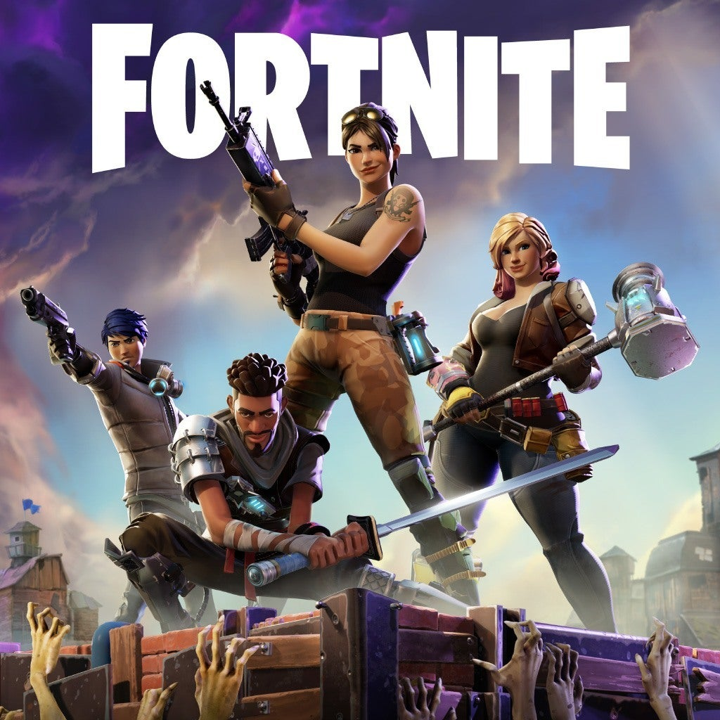
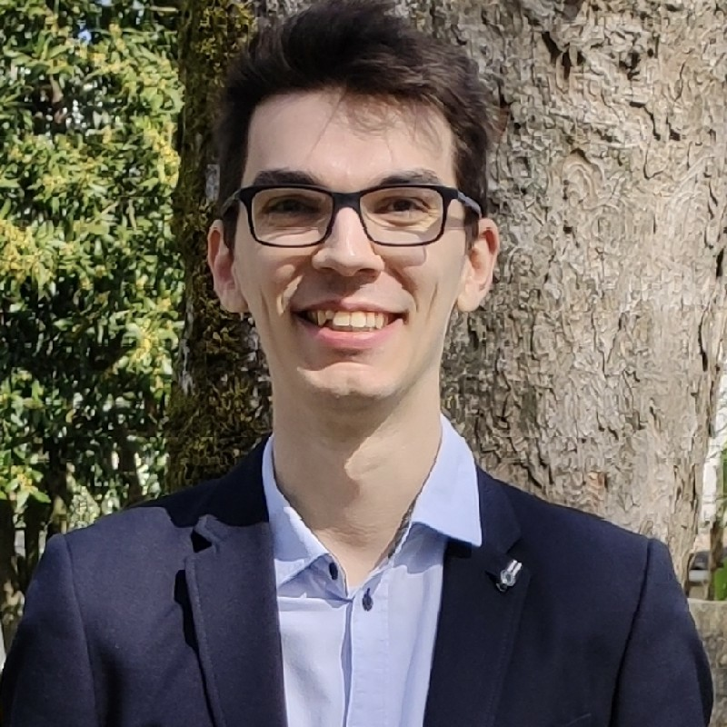
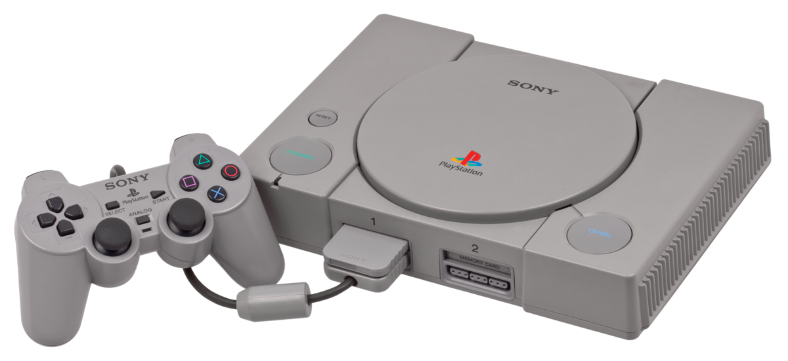
1995

Slide 7
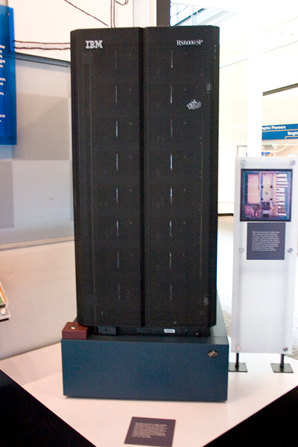
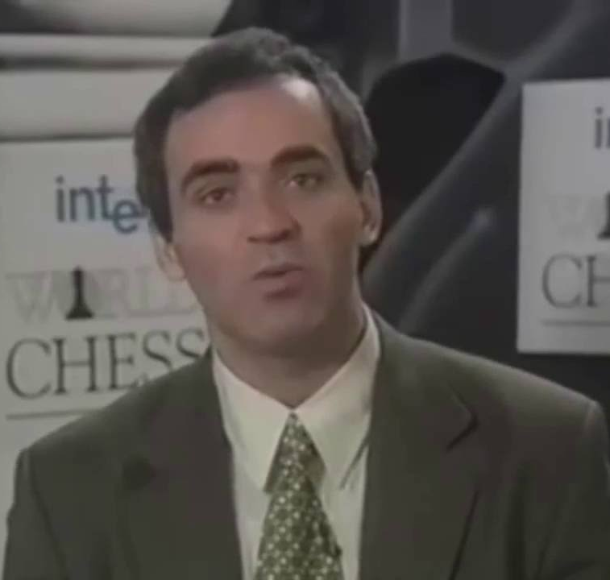
VS
Kasparov a.k.a. at the time
as the GOAT of chess
A Black Wii a.k.a.
Deep Blue
Notes:
Solving chess = key towards general intelligence 11.8GFlops = Wii 51,000$ / GFlop now 0.02$ /GFlop
Kind of a “Chinese room experiment”

Slide 8
How did DeepBlue work?
𝛂-𝛃 + Chess Heuristics + Specialised Chips
Notes:
200 millions de positions/sec
taille de la gravure 60 fois plus importante
alpha-beta (58-63)
Paper = how they designed specific chips for performance

Slide 9
What did we learn?
Nothing…
Notes:
Richard Sutton says to work on things that scale not on thing with a nice payoff because we always have Moore’s law as a backup

Slide 10
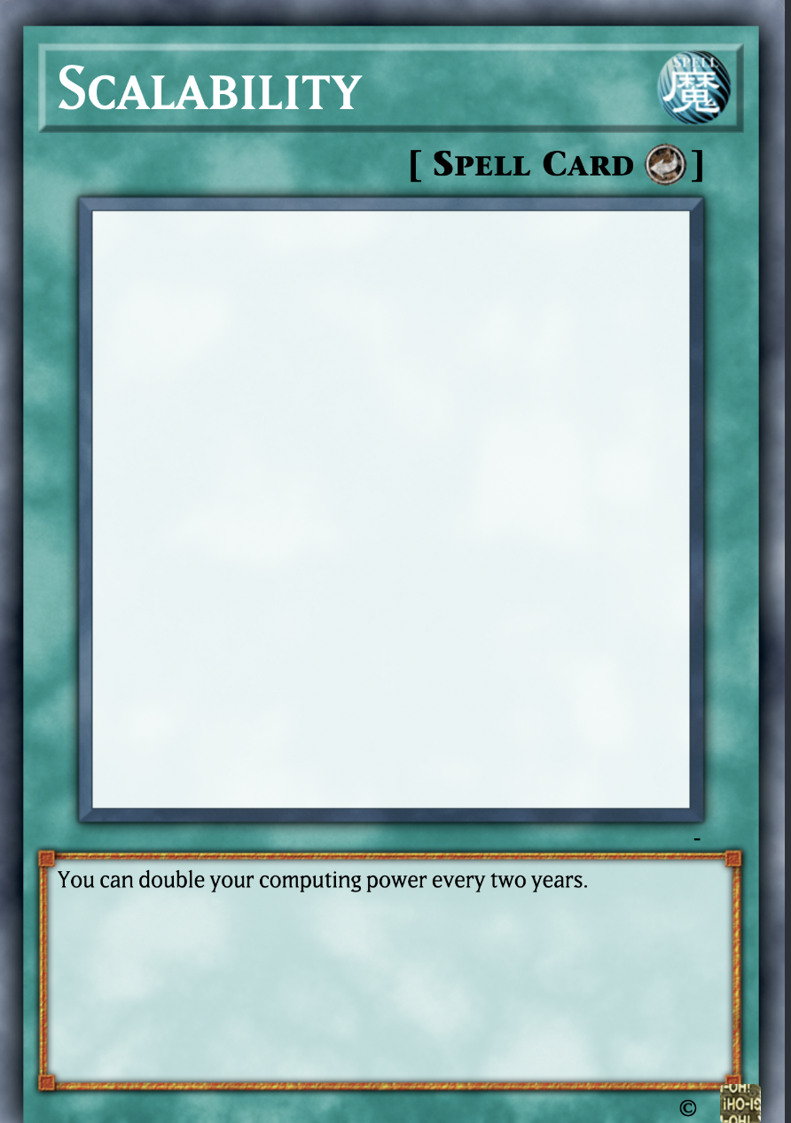
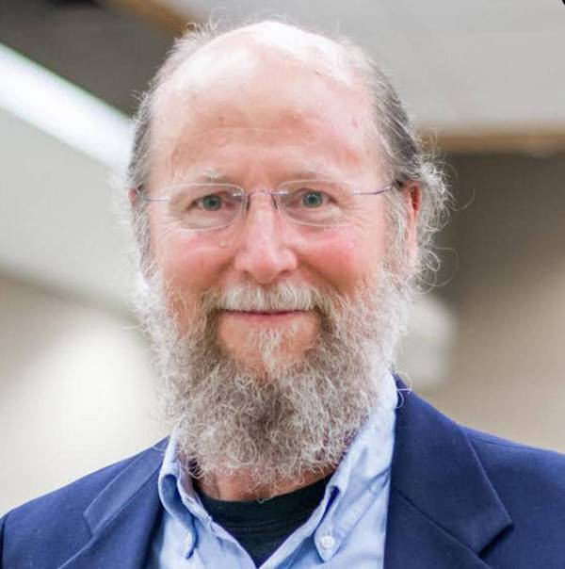
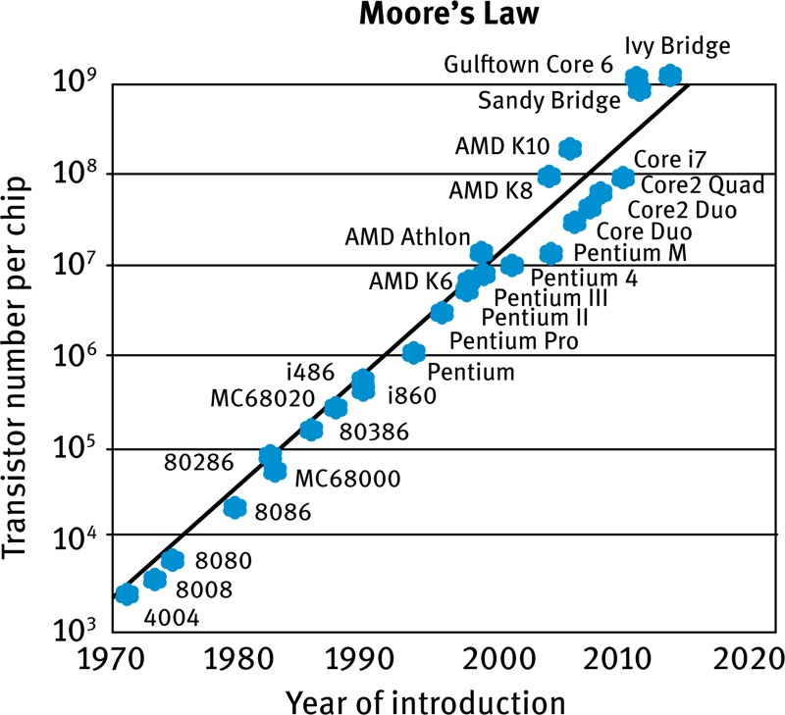
Richard Sutton a.k.a
one of the father of classical RL
Notes:
Richard Sutton says to work on things that scale not on thing with a nice payoff because we always have Moore’s law as a backup

Slide 11
Then let’s do the same for Go!
i.e. not learn anything

Slide 12
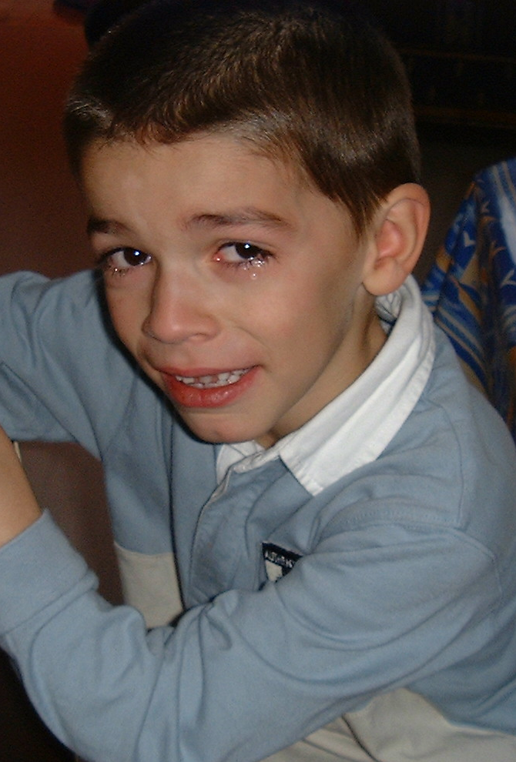
It doesn’t work!
Notes:
It doesn’t work…. :/ but why?

Slide 13
Game tree complexity = b^{d}
Branching Factors:
Chess: 35
Go : 250
Notes:
The main reason is this.
If we only relied on Moore’s law in: 2016: 20y = 2 ^10 => 8 ^3 => depth 3 2022: 24y = 2 ^ 12 => 8 ^ 4 => depth 4
to get there we need 8^8 => 2^24 => 48 years => 2045

Slide 14
TO BE CONTINUED AFTER A SHORT AD BREAK

